Slide 1

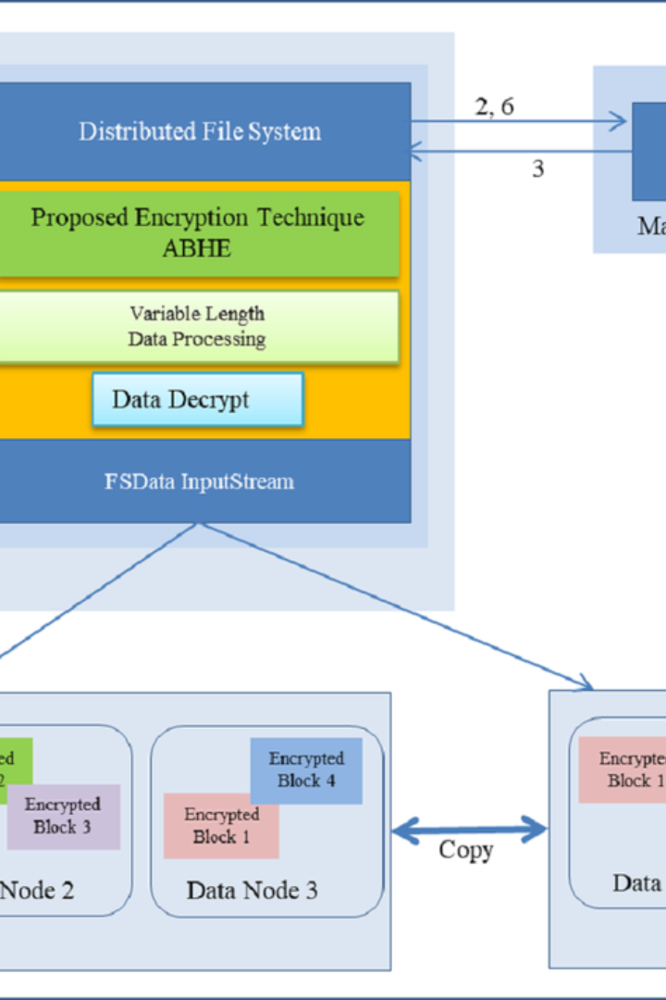


Hadoop File System Essentials
Learn the fundamental operations for managing Hadoop Distributed File System (HDFS) with these clear instructions and examples.
by Rohit Chapalamadugu

Slide 2
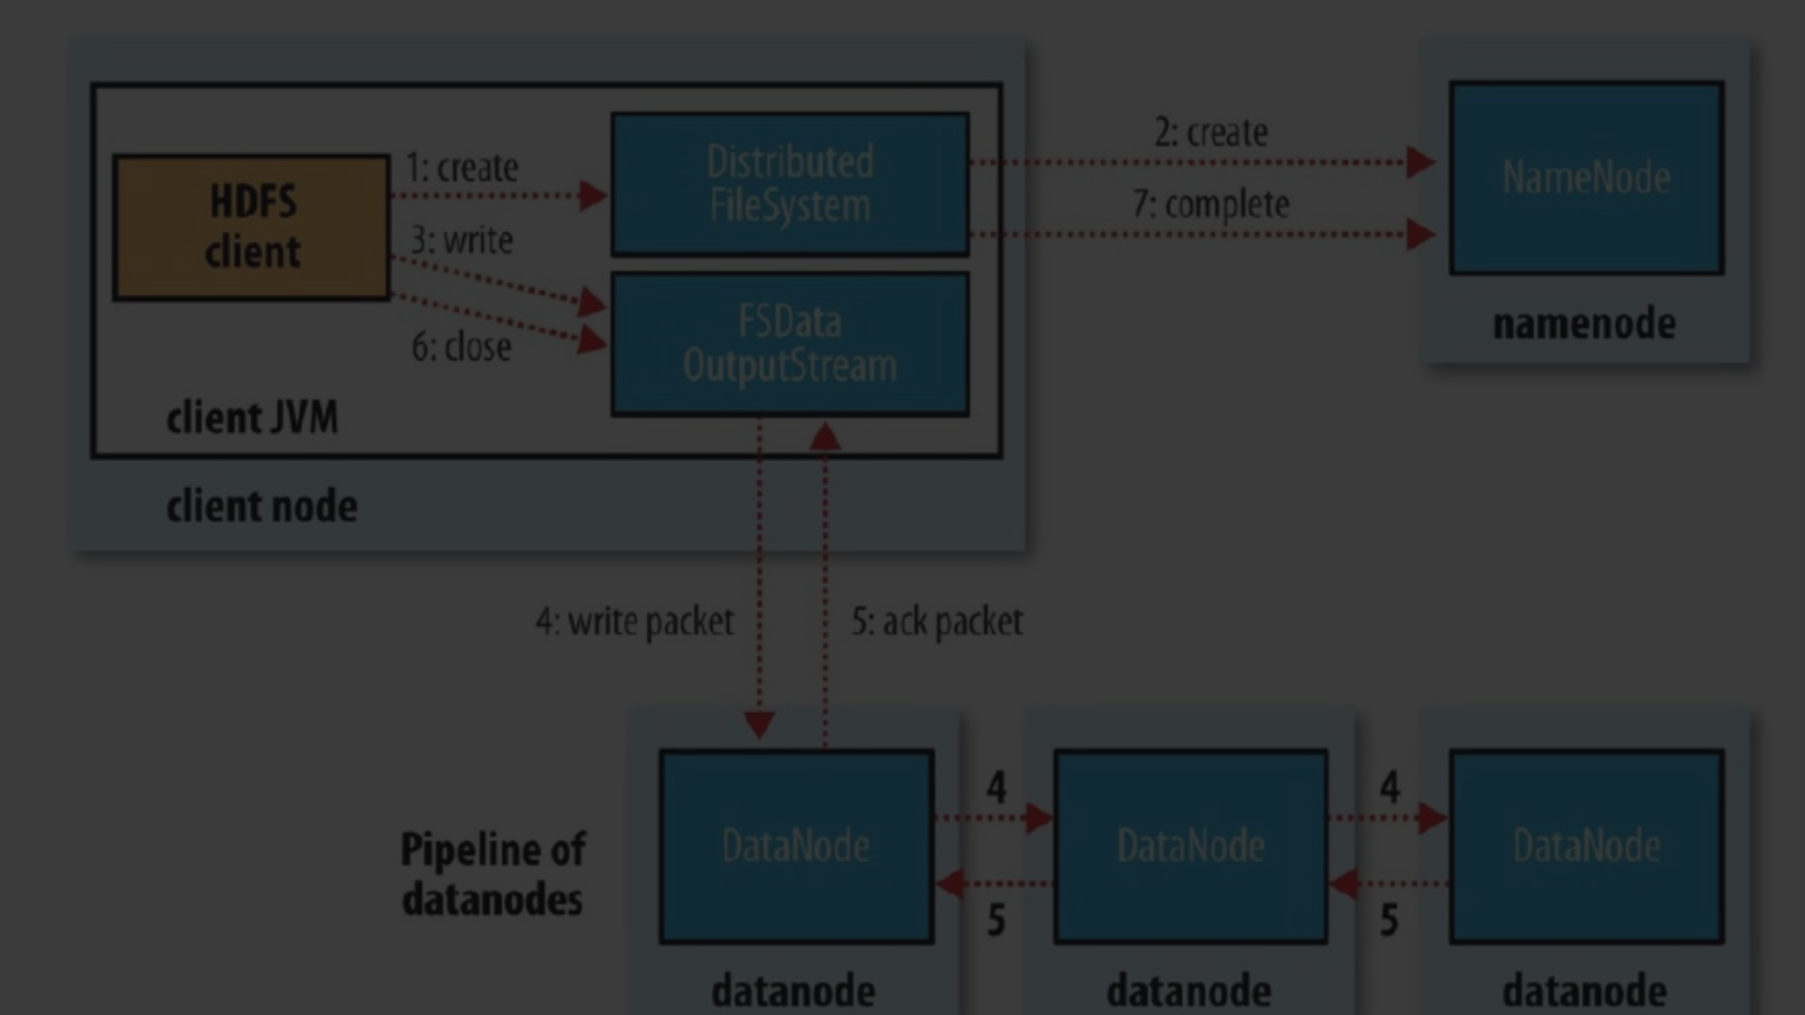
Creating a Directory Structure in HDFS
1
Step 1: Understand the Command
Use the hadoop fs -mkdir command to create directories in HDFS.
2
Step 2: Example
For instance, use hadoop fs -mkdir /mydata to create a directory in the root of HDFS.

Slide 3
Moving Files to HDFS
hadoop fs -put
Local Machine to HDFS
Move files from local Unix/Linux to HDFS with the hadoop fs -put command.
Transfer files from your machine to HDFS efficiently.
For example, hadoop fs -put example.txt /mydata.

Slide 4
Viewing Data and Contents
1
View File Contents
2
Listing Files and Directories
3
Easy Access
Quickly access file and directory contents in Hadoop.
Use hadoop fs -cat to see the contents of a file in HDFS.
Get an overview with hadoop fs -ls for file and directory contents.

Slide 5
Getting Files from HDFS to Local Disk
To Local Disk
From HDFS
hadoop fs -get
Copy files to local file system

Slide 6
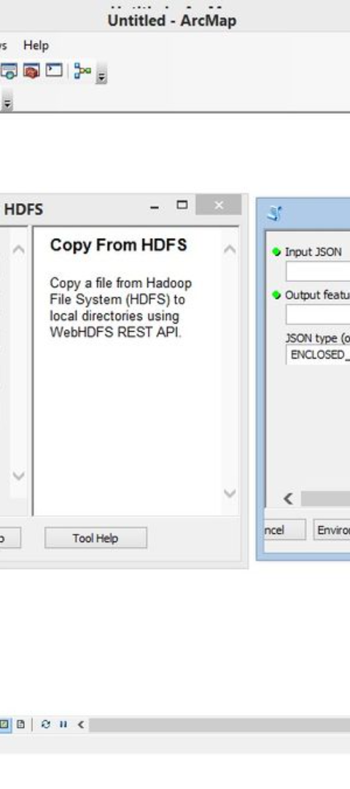
Essential Commands Recap
Commands
Use Cases
Recap the fundamental Hadoop commands for HDFS operations.
Understand and apply the commands in relevant use cases.

Slide 7
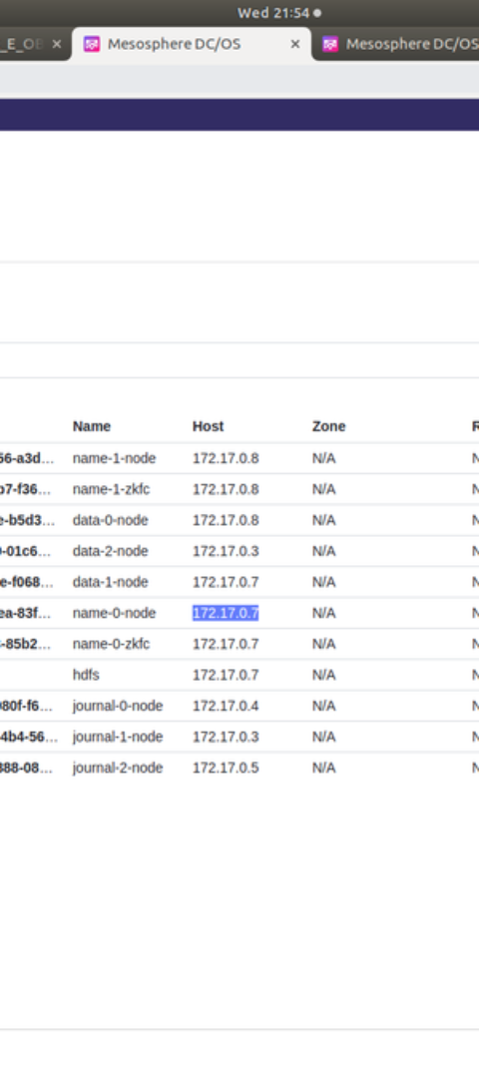



Basic HDFS Operations
Step 1
Create HDFS directory structure
Step 2
Transfer files from local machine to HDFS
Step 3
View and access file contents in HDFS

Slide 8
Conclusion
1
2
Understanding HDFS
Practical Applications
3
4
Increased Efficiency
Skill Development
Mastering HDFS basics is essential for efficient data management and processing in Hadoop environments.

